Slide 1
CS 4530: Fundamentals of Software Engineering
Module 15: Software Engineering & Security
Adeel Bhutta and Mitch Wand
Khoury College of Computer Sciences
© 2025, released under CC BY-SA

Slide 2
Learning Objectives for this Module
By the end of this module, you should be able to:
Define key terms relating to software/system security
Describe some of the tradeoffs between security and other requirements in software engineering
Explain 5 common vulnerabilities in web applications and similar software systems, and describe some common mitigations for each of them.
Explain why software alone isn’t enough to assure security

Slide 3
Outline of this lecture
Definition of key vocabulary
Some common vulnerabilities, and possible mitigations
Getting security right is about people as well as software.
Notes:
<Read slide>
Part 2 is the largest portion of the lecture.

Slide 4
Security: Basic Vocabulary (1)
Security is a set of non-functional requirements (sometimes called “CIA”):
Confidentiality: is information disclosed to unauthorized individuals?
Integrity: is code or data tampered with?
Availability: is the system accessible and usable?
Notes:
Security is often considered a broad non-functional requirement: systems are expected to be “secure”. But as we’ll see in this lecture, security covers a range of different security requirements. Here are three common security requirements.
Confidentiality - is information disclosed to unauthorized parties?
Integrity - is our code or data tampered with, at rest, or in transit
Availability - Can someone prevent my system from otherwise functioning? note that leaving something unplugged solves confidentiality and integrity :)
Discussion: Think about recent examples of security events and how they violated these properties

Slide 5
Security: Basic Vocabulary (2)
Asset: something of value that is the subject of a security requirement
Threat: potential event that could compromise a security requirement
Security architecture: a set of mechanisms and policies that we build into our system to mitigate risks from threats

Slide 6
Security: Basic Vocabulary (3)
Vulnerability: a characteristic or flaw in system design or implementation, or in the security procedures, that, if exploited, could result in a security compromise
Exploit: a technique or method for exploiting a vulnerability
Attack: realization of a threat
Mitigation: a technique for making an attack less likely, more expensive, or less valuable to an attacker.

Slide 7

Security isn't always free
In software, as in the real world…
You just moved to a new house, someone just moved out of it. What do you do to protect your belongings/property?
What are the assets that need protection?
residents, furniture, cash, your stuff
What are the vulnerabilities?
doors, windows
Notes:
Before getting into software security, let’s talk a bit about physical security. Imagine that you have just moved to a new house, and someone just moved out. Are there things that you would want to do to secure your belongings? For instance - do you change the locks? Maybe you are concerned that the former tenant still has keys.
(Walk through example, then ultimately point out that you live in a house with lots of glass)

Slide 8
What are the threats? What are possible mitigations?
Threat/Exploit | Mitigation
Fire | Smoke alarm, fire extinguisher
Hurricane | Strengthen windows; raise house; move away
Burglary | Burglar alarm? Better locks? Strengthen windows?
Former owner has keys | Change locks
Terrorism | ???
Nuclear war | ????
???

Slide 9
Security is about managing risk
Increasing security might:
Increase development & maintenance cost
Increase infrastructure requirements
Degrade performance
But, if we are attacked, increasing security might also:
Decrease financial and intangible losses
How likely do we think we are to be attacked in some particular way?
Notes:
We saw in the example of the new home that there may be some security measures that seem needlessly expensive (hiring a security guard) or expensive AND counter to some of our other requirements (replacing glass windows with blast doors increases security at the expense of aesthetics).
Let’s think about this in the case of an IT system.
Here are some examples of the kinds of tradeoffs that we might consider when thinking about these threats.(read slide)
Ultimately, the last question of “how likely we are to be attacked in some way” is going to be very subjective, and we will need to consider the financial cost of a successful attack – attacks with very large payoffs (for the attacker) might motivate attackers to try harder.

Slide 10
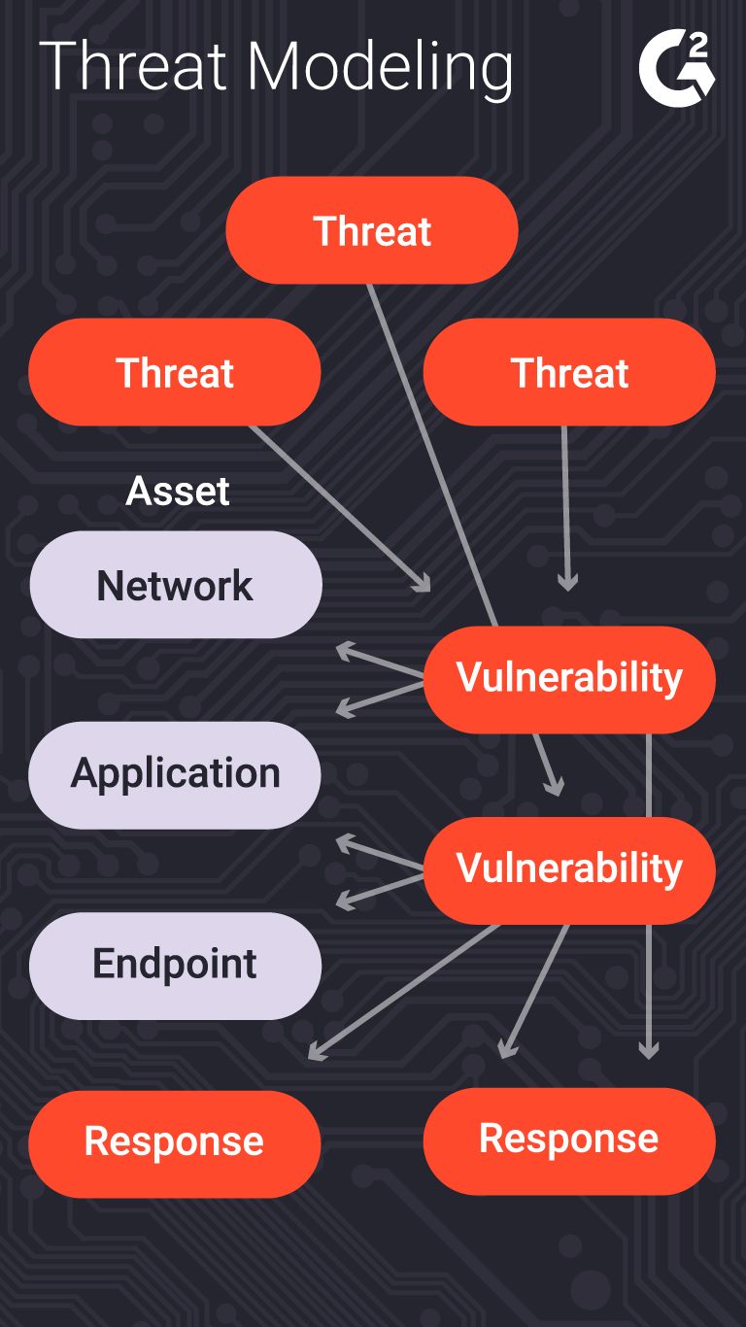
Threat modeling can help us analyze the issues
What is being defended?
What malicious actors exist and what attacks might they employ?
What value can an attacker extract from a vulnerability?
Who do we trust? What parts of the system do we trust?
What can we do in case of attack?
Notes:
The process of considering the potential risks, and ”non risks”, or trusted actors/components, is called “threat modeling”.
This is typically a structured process in which an organization analyzes questions like:
(read slide)
Of course, creating a threat model is not a one-time event. The model will need to be continually revised during the development process as the system is refined, and after deployment as the environment changes.
Of course there’s a whole ecosystem of consultants to help with this process.

Slide 11
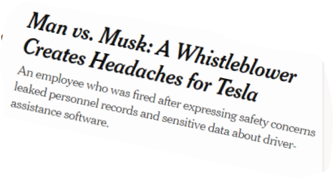
A Baseline Threat Model
Trust:
Developers writing our code (at least for the code they touch)
Server running our code
Popular dependencies that we use and update
Don’t trust:
Code running in browser
Inputs from users
Other employees (employees should have access only to the resources they need)
Notes:
For some of these questions, there are baseline answers that are widely applicable.
Re last bullet: Remember that insider attacks are common!

Slide 12
A Baseline Security Policy
Encrypt all data in transit, sensitive data at rest
Use multi-factor authentication
Use encapsulated zones/layers of security
Different people have access to different resources
Principle of Least Privilege
Log everything! (employee data accesses/modifications) (maybe)
Do regular, automatic, off-site backups
Bring in security experts early for riskier situations
Notes:
Before, we said that a security architecture is a set of mechanisms and policies that we build into our system to mitigate risks from threats.
Luckily, there are best practices that are applicable in most situations. The extent to which we implement these practices will depend on the other factors in our threat model.
Consider two-factor authentication. We all have to deal with it; it’s always painful to have a 2FA pop up to delay us in accomplishing some task.
What processes in our system do we want to protect with 2FA? User or developer login? (Almost certainly yes). What else? Can you imagine having to do a 2FA on every commit?

Slide 13
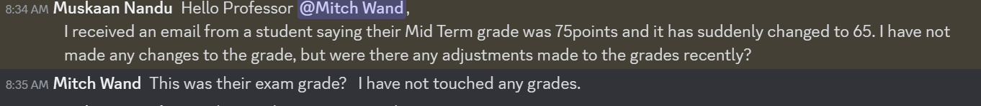
How much should you log?
Notes:
Here’s an example of where a threat model would be helpful. Prof. Wand says: While I was preparing these slides, I received the following message from a TA:
<show clip>
Here is evidence of an attack (probably not malicious in this case, but still…)
Let’s analyze this in terms of our threat model
-- What is the asset that has been compromised?
-- What security requirement has been violated (C? I? A?)
-- What is the threat?
-- Did we make a bad assumption about who we should trust?
[Discuss!]
As it turns out, Canvas keeps a history of all changes to student grades, so this issue was easily tracked down (whew!)

Slide 14
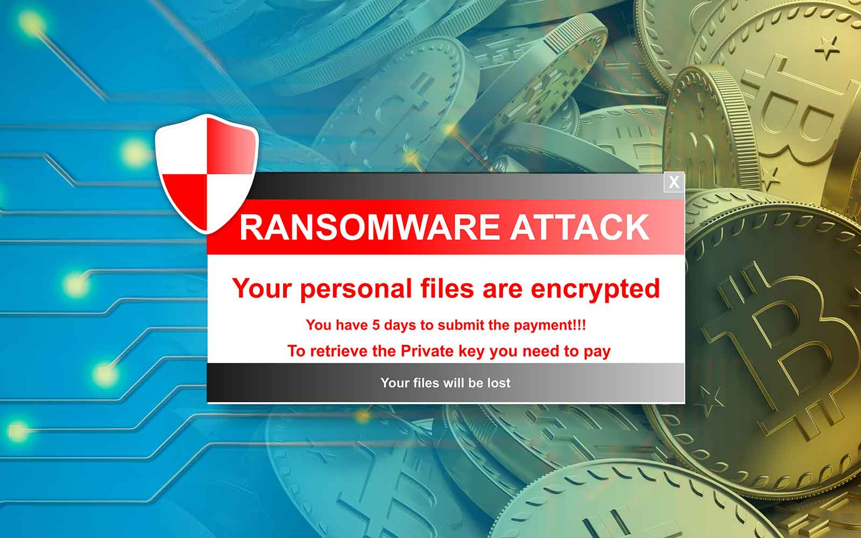
Backups can mitigate the risks of a ransomware attack
Notes:
Backups are best when they are automated, so you don’t forget.
They are also best when they are frequent, so your backup is always up to date or close to it.

Slide 15

Off-site backups mitigate the risks of natural disasters
Notes:
Enough said!

Slide 16
In the remainder of this module, we will discuss 5 major classes of vulnerabilities
Vulnerability 1: Code that runs in an untrusted environment
Vulnerability 2: Untrusted Inputs
Vulnerability 3: Bad authentication (of both sender and receiver!)
Vulnerability 4: Malicious software from the software supply chain
Vulnerability 5: Failure to apply security policy.
https://owasp.org/www-project-top-ten/
Notes:
Here are 5 general classes of vulnerabilities. For each vulnerability, we will look at possible exploits and possible mitigations.
An unfortunate recurring theme that we will see in these defenses is that there is no silver bullet. An extremely motivated attacker (say, a nation-state like the US, China, or Russia) can likely, with enough time and resources, break into anything. But, we will see what we can do to increase the cost of that attack.

Slide 17

Vulnerability 1 Example: authentication code in a web application
function checkPassword(inputPassword: string){
if(inputPassword === 'letmein'){
return true;
}
return false;
}
Front End
Curses! Foiled Again!
User controls this
Trust boundary
Back End
Fix: Move code to back end (duh!)
We control this
Notes:
What if we put some sensitive code in the front end of our web app? In general, there’s nothing to prevent the user from looking at the code or modifying it. Here, the correct password is sitting in plaintext where the user can find it.
That’s an extreme example, of course, but there are others: the user might be able to extract keys and other secrets from the front-end code.
The general fix to this is to move that sensitive code into our backend, which we should, hopefully, trust to faithfully execute the code.
Another example: if we have external services (like a database, or some other API, like one for accessing cloud resources), we might be tempted to distribute our database password (or key for third party API) with the application, so that it can directly connect to our database.
Our frontend might try to restrict what data the user can access, but because the user can also use these credentials to directly connect to our database, they will have the power to do whatever is permitted for those credentials.
(Professor Wand says: yes, this animation is cheesy, but I had way too much fun doing it).

Slide 18
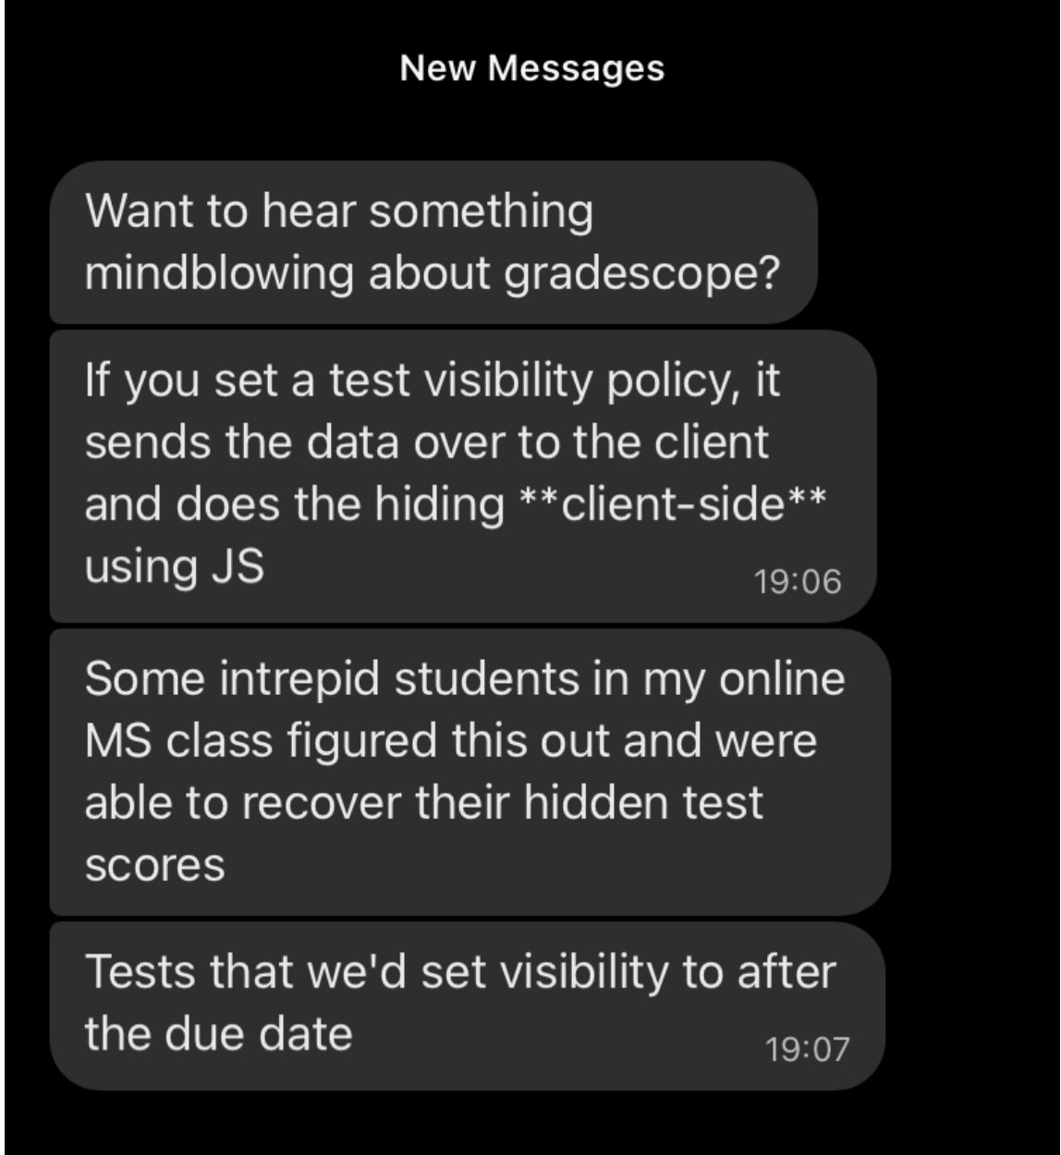
Who would do such a silly thing?
Notes:
<click>
Answer: Gradescope!

Slide 19
Vulnerability 2: Data controlled by a user flowing into our trusted codebase
https://xkcd.com/327/
Notes:
The next class of threat that we will consider is: untrusted user inputs. Imagine that we have solved our problem of “do we trust where the code runs” by running that code on our own server that we control. Surely, we still receive inputs from users, who we should not trust.
Here is a pop-culture reference from XKCD that makes fun of this class of threat

Slide 20
Example: code injection
String query = "SELECT * FROM accounts WHERE name='" + request.getParameter(“name") + "'";
Parameter name | Constructed Query | Effect
Alice | SELECT * FROM accounts WHERE name=‘Alice’; | Select a single account
Alice O’Neal | SELECT * FROM accounts WHERE name=‘Alice O’Neal’; | SQL Error
5’ OR ‘1’=‘1 | SELECT * FROM accounts WHERE name=‘5’ OR ‘1’=‘1’; | Select all accounts
OOPs!
OWASP A03:2021-Injection
Notes:
Here’s a real example. By putting in a suitably crafted query into an innocuous-looking query, a user could select ALL accounts in the database. This is one of the items in the OWASP list of most common vulnerabilities (the link is on the slide, and also in the resources links for this lecture). OWASP stands for the Oen Web Application Security Project.

Slide 21
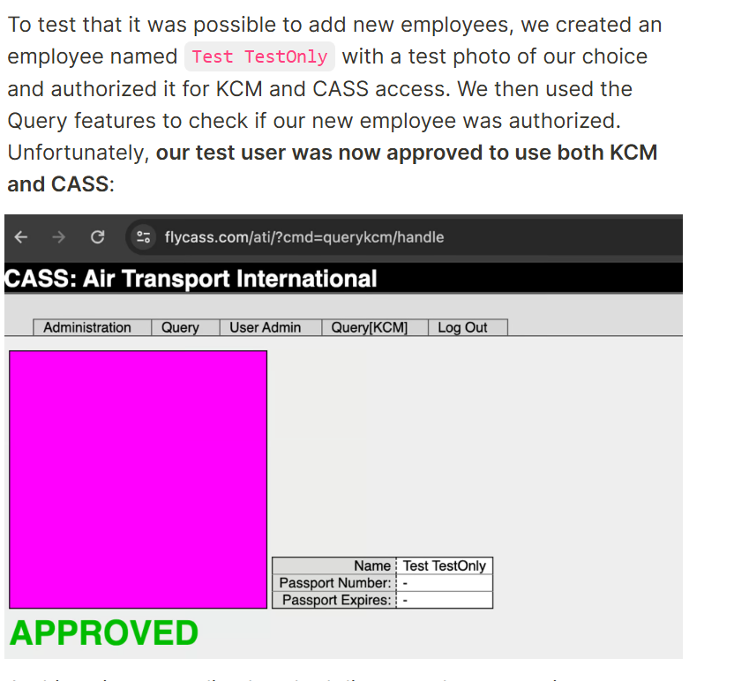
Bypassing airport security via SQL injection (2024!)
"Known Crewmembers" can get to the cockpit without inspection.
Large airlines: Each airline runs its own authorization system, but small airlines rely on a vendor
The authors found one such vendor that had an SQL injection error
Using the username of ' or '1'='1 and password of ') OR MD5('1')=MD5('1, we were able to login to FlyCASS as an administrator of Air Transport International!
OOPs!
https://ian.sh/tsa
Notes:
Followup: After the authors identified the problem, they attempted to report it. On the website they wrote:
We ended up finding several more serious issues but began the disclosure process immediately after finding the first issue.
We had difficulty identifying the right disclosure contact for this issue. We did not want to contact FlyCASS first as it appeared to be operated only by one person and we did not want to alarm them. On April 23rd, we were able to disclose the issue to the Department of Homeland Security, who acknowledged the issue and confirmed that they “are taking this very seriously”. FlyCASS was subsequently disabled in KCM/CASS and later appears to have remediated the issues.
After the issue was fixed, we attempted to coordinate the safe disclosure of this issue. Unfortunately, instead of working with us, the Department of Homeland Security stopped responding to us, and the TSA press office issued dangerously incorrect statements about the vulnerability, denying what we had discovered.

Slide 22
Using the username of ' or '1'='1 and password of ') OR MD5('1')=MD5('1, we were able to login to FlyCASS as an administrator of Air Transport International!

Slide 23

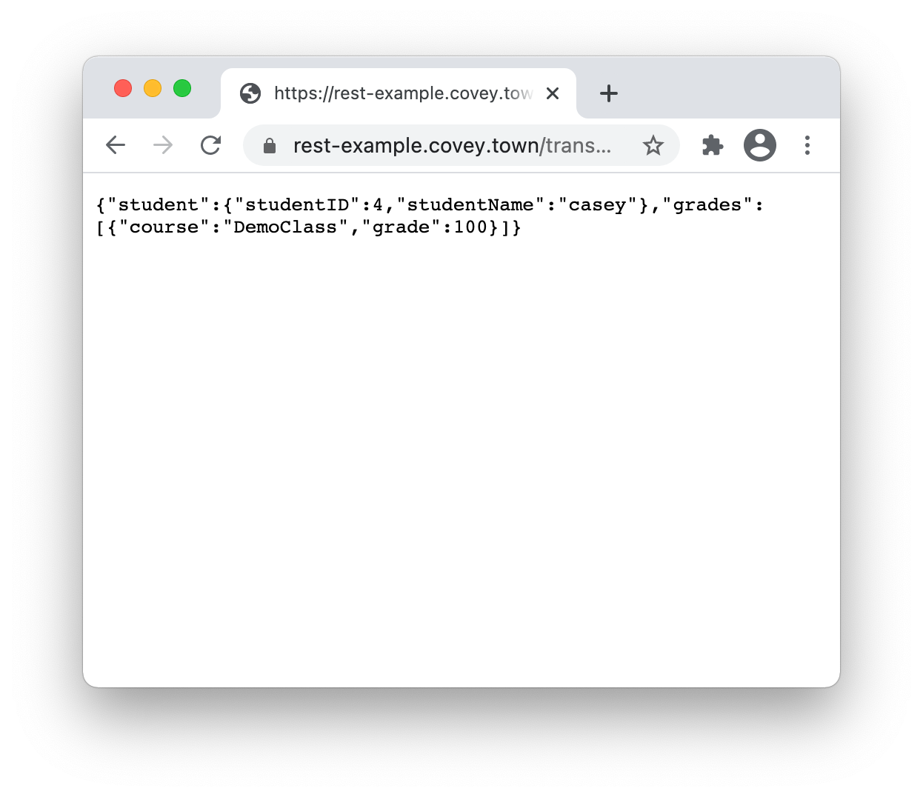
Example: Cross-site scripting (XSS)
app.get('/transcripts/:id', (req, res) => {
// req.params to get components of the path
const {id} = req.params;
const theTranscript = db.getTranscript(parseInt(id));
if (theTranscript === undefined) {
res.status(404).send(`No student with id = ${id}`);
}
{
res.status(200).send(theTranscript);
}
});
Trusted Server
/transcripts/4
Notes:
Here is a concrete example of how this threat can be realized in a common web app, even one that doesn’t use a database.
Here’s some hand-built code for a transcript server like the one we used in the Async activity.
Let’s step through what this code does: it reads the ID from the Url parameter, then retrieves the relevant transcript. If no transcript is found, we return an error, and if not, we return the transcript.
Note that there is a user input (the student ID) that flows directly into the response. This is a vulnerability: a malicious user (like little Bobby Tables) could insert a carefully crafted input that, when accessed, shows content that we (the authors of the transcript server) did not intend.
Note also that generating this endpoint with a tool like tsoa, rather than writing it by hand, effectively prevents XSS attacks against it.
But let’s see how the vulnerability works in this plausible hand-written code.

Slide 24
Example: Cross-site scripting (2)
app.get('/transcripts/:id', (req, res) => {
// req.params to get components of the path
const {id} = req.params;
const theTranscript = db.getTranscript(parseInt(id));
if (theTranscript === undefined) {
res.status(404).send(`No student with id = ${id}`);
}
{
res.status(200).send(theTranscript);
}
});
Trusted Server
/transcripts/%3Ch1%3e…
<h1>Congratulations!</h1>
You are the 1000th visitor to the transcript site! You have been selected to receive a free iPad. To claim your prize <a href='https://www.youtube.com/watch?v=DLzxrzFCyOs'>click here!</a>
<script language=“javascript”>
document.getRootNode().body.innerHTML=
'<h1>Congratulations!</h1>You are the 1000th visitor to the transcript site! You have been selected to receive a free iPad. To claim your prize <a href="https://www.youtube.com/watch?v=DLzxrzFCyOs">click here!</a>’;
alert('You are a winner!’);
</script>
Notes:
What if the attacker sends a string like this? <click> They would have to do a lot of escaping with % signs to get all the funny characters, but a motivated attacker could do that pretty easily.

Slide 25

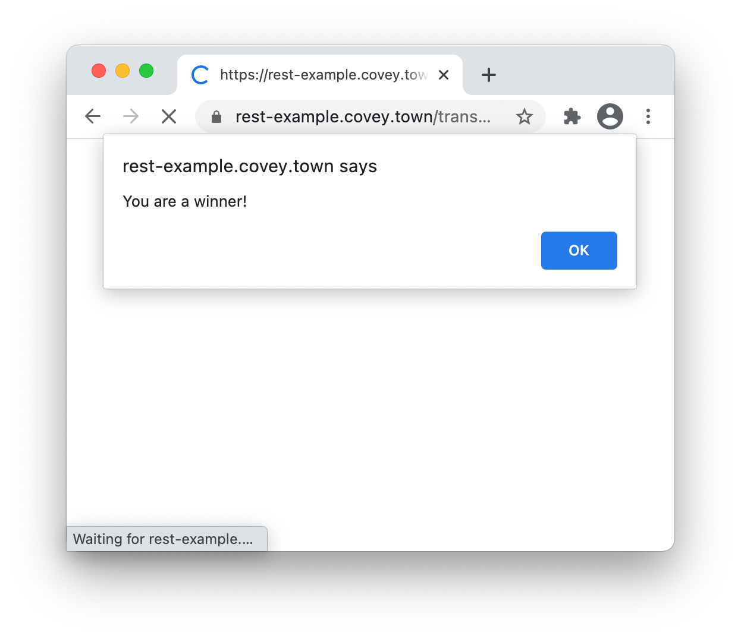
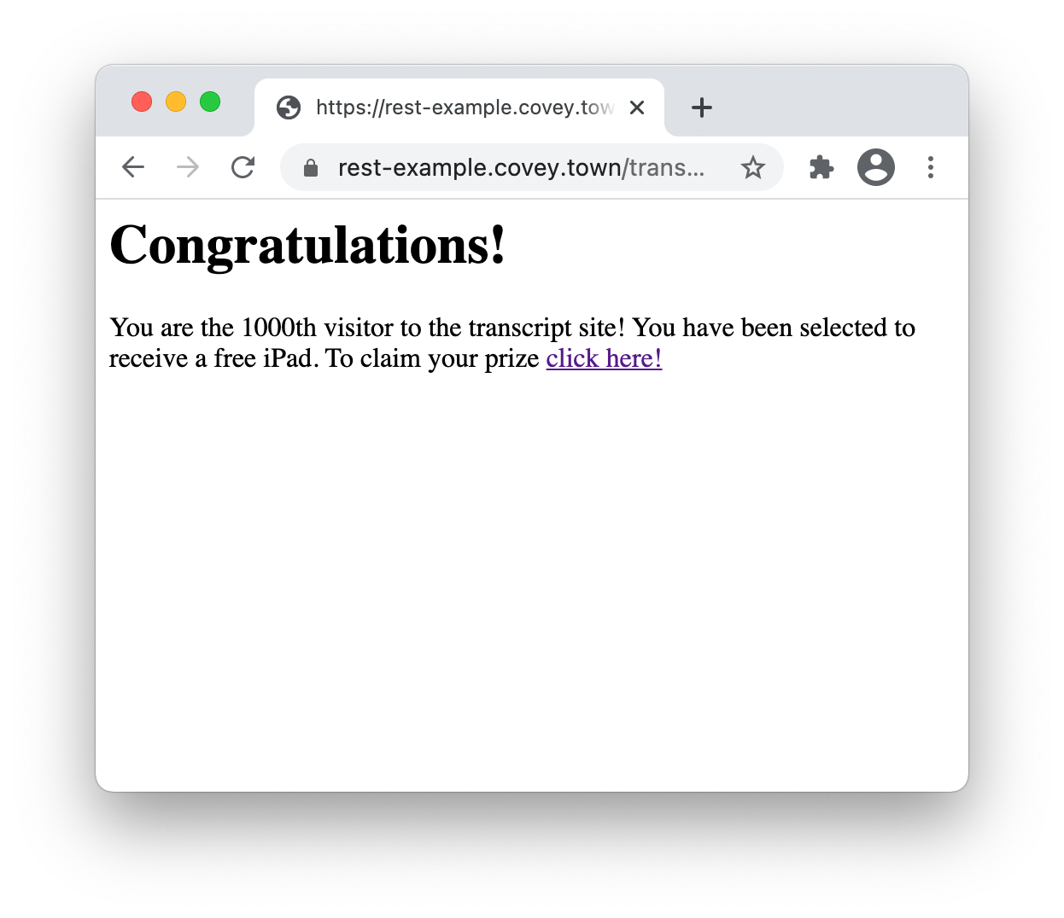
Example: Cross-site scripting (3)
app.get('/transcripts/:id', (req, res) => {
// req.params to get components of the path
const {id} = req.params;
const theTranscript = db.getTranscript(parseInt(id));
if (theTranscript === undefined) {
res.status(404).send(`No student with id = ${id}`);
}
{
res.status(200).send(theTranscript);
}
});
Trusted Server
/transcripts/%3Ch1%3e…
<h1>Congratulations!</h1>
You are the 1000th visitor to the transcript site! You have been selected to receive a free iPad. To claim your prize <a href='https://www.youtube.com/watch?v=DLzxrzFCyOs'>click here!</a>
<script language=“javascript”>
document.getRootNode().body.innerHTML=
'<h1>Congratulations!</h1>You are the 1000th visitor to the transcript site! You have been selected to receive a free iPad. To claim your prize <a href="https://www.youtube.com/watch?v=DLzxrzFCyOs">click here!</a>’;
alert('You are a winner!’);
</script>
By Never Gonna Give You Up music video., Fair use, https://en.wikipedia.org/w/index.php?curid=22192466
Notes:
<Demo in MS Edge!>
<Then demo in Chrome>
If you opened this link in MS Edge, it would show the alert on the left <click>, and then the message on the right. <click> What happens if you click the link where it says “click here”? <click>
Luckily, this is not a vulnerability for us, because we use the TSOA library to generate our servers, and TSOA would not generate code like this.
Browsers have gotten much better about preventing cross-site scripting. But they will never be perfect.
Realistic XSS attacks might use this JS code to steal users’ credentials from their browser tab, or to perform a social engineering attack like this one

Slide 26
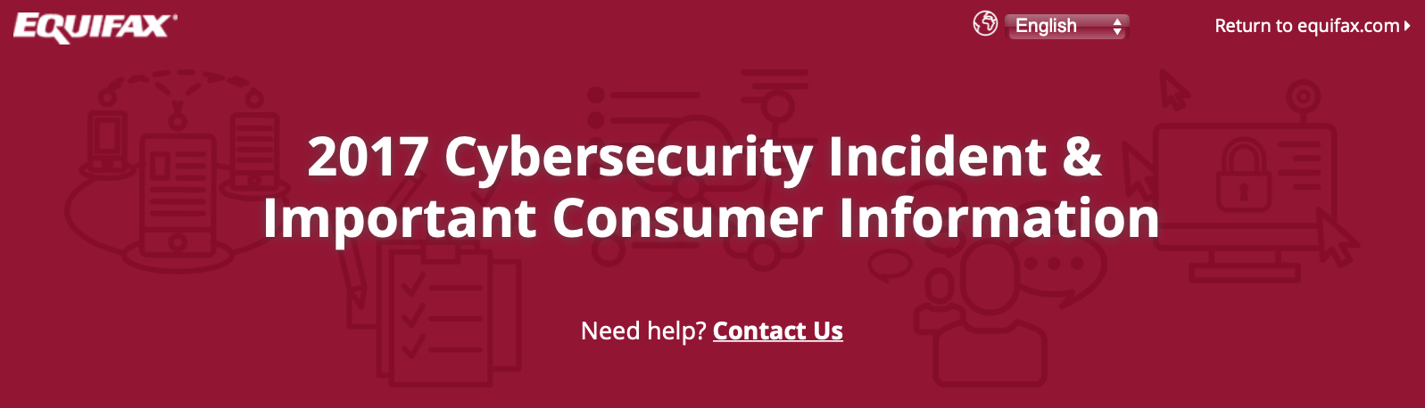
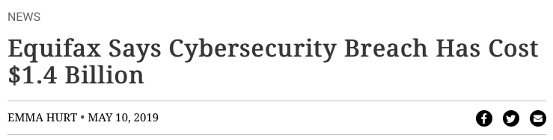
A code injection attack (in Apache struts) cost Equifax $1.4 Billion
CVE-2017-5638 Detail
Current Description
The Jakarta Multipart parser in Apache Struts 2 2.3.x before 2.3.32 and 2.5.x before 2.5.10.1 has incorrect exception handling and error-message generation during file-upload attempts, which allows remote attackers to execute arbitrary commands via a crafted Content-Type, Content-Disposition, or Content-Length HTTP header, as exploited in the wild in March 2017 with a Content-Type header containing a #cmd= string.
Notes:
For example: the Equifax data breach in 2017 that has thus-far cost the firm over 1.4 billion dollars was caused by a vulnerability in their web app, which allowed untrusted user input to flow into a part of the application that would then execute that input as java code.

Slide 27
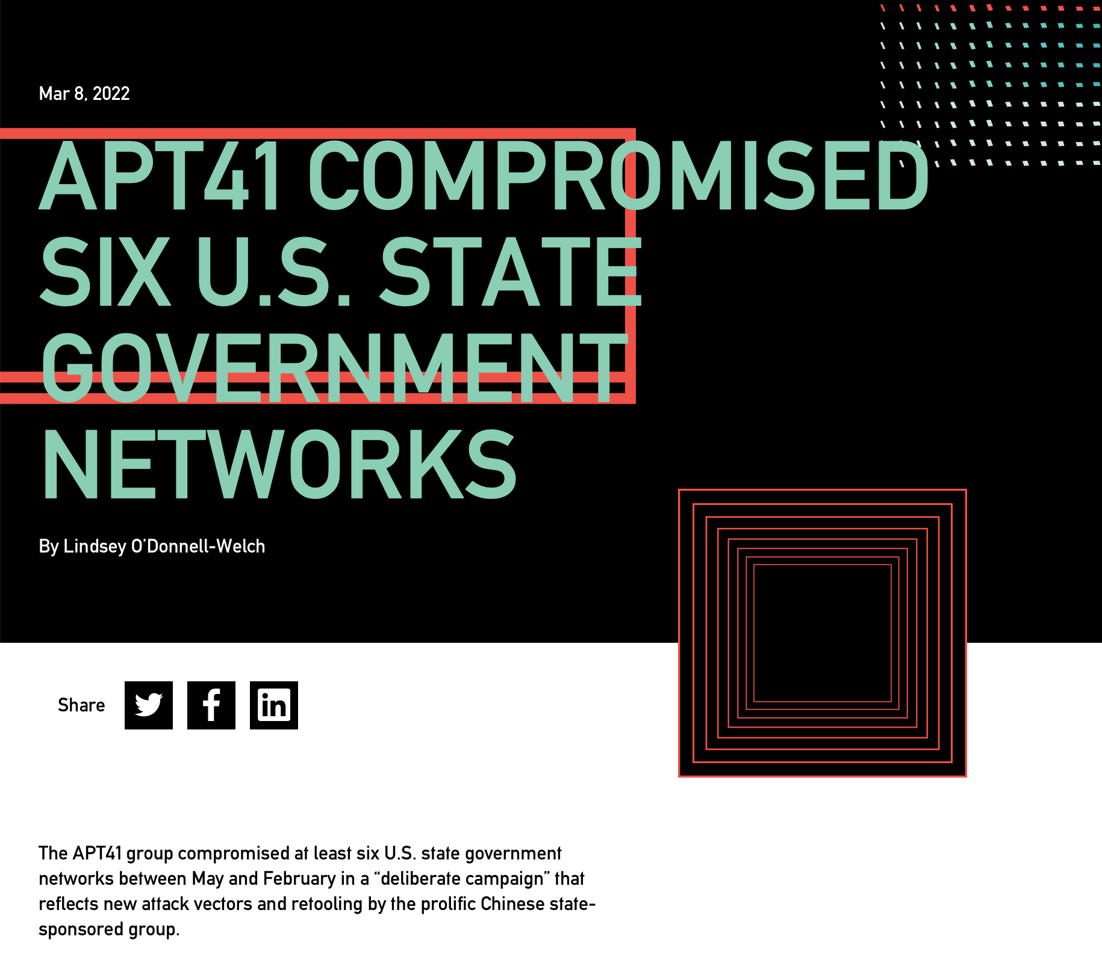
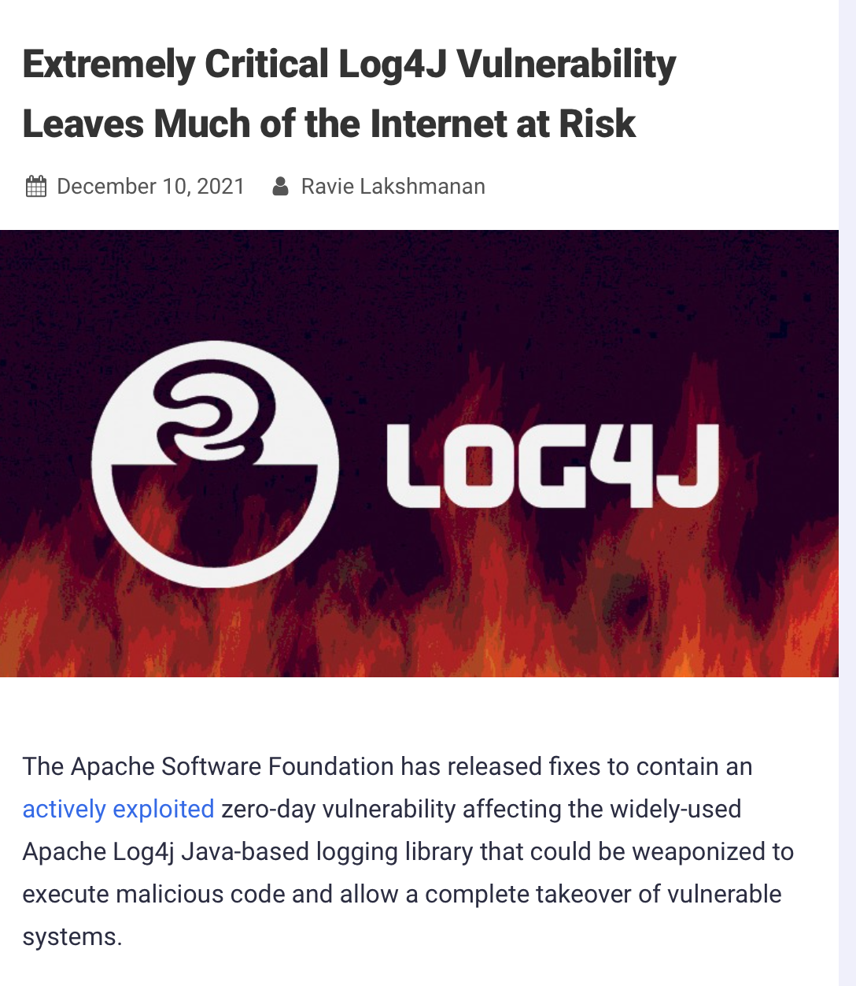
The Log4J code injection vulnerability compromised many networks in 2021
CVE-2021-44228 Detail
Current Description
Apache Log4j2 2.0-beta9 through 2.15.0 (excluding security releases 2.12.2, 2.12.3, and 2.3.1) JNDI features used in configuration, log messages, and parameters do not protect against attacker controlled LDAP and other JNDI related endpoints. An attacker who can control log messages or log message parameters can execute arbitrary code loaded from LDAP servers when message lookup substitution is enabled. From log4j 2.15.0, this behavior has been disabled by default. From version 2.16.0 (along with 2.12.2, 2.12.3, and 2.3.1), this functionality has been completely removed. Note that this vulnerability is specific to log4j-core and does not affect log4net, log4cxx, or other Apache Logging Services projects.
https://nvd.nist.gov/vuln/detail/CVE-2021-44228
https://thehackernews.com/2021/12/extremely-critical-log4j-vulnerability.html
https://duo.com/decipher/apt41-compromised-six-state-government-networks
Notes:
You might think that we have learned a lesson and that we wouldn’t have this kind of vulnerability any more. The Log4J vulnerability in Fall of 2021 was successfully used to compromise many networks, and (click build) was also due to an issue where user-controlled inputs could be executed as code on a trusted component (the directory/LDAP server in this case)

Slide 28
Mitigating against code injection attacks
Use tools like TSOA to automatically generate safe code.
Manually sanitize inputs to prevent them from being executable
Avoid unsafe query languages (e.g. SQL, LDAP, language-specific languages like OGNL in java). Use “safe” subsets instead.
Avoid use of languages (like C or C++) that allow code to construct arbitrary pointers or write beyond a valid array index
eval() in JS – executes a string as JS code
Notes:
Special characters like <, >, ‘, “ and ` are often involved in exploits involving untrusted inputs. So filter them, and use tools to make sure that every data flow involving user input is filtered.
Query languages might have “safe” apis and “unsafe” APIs, where the “Safe” APIs automatically perform some sanitization, allowing you to add place-holders for arguments to a query that YOU define, where the user-controlled input can ONLY flow into a specific part of the query (preventing the attacker from constructing their own query)
Don’t use “unsafe” languages like C or C++. In these languages you can write beyond a valid array index. Such buffer overflows are the primary way in which an attacker can execute arbitrary code on your app. (There are whole conferences devoted to ways of preventing this.)
And of course don’t use ‘eval’ in JS. Use a lint filter to check for this.

Slide 29
Vulnerability 3: Bad Authentication
HTTP Request
Server
HTTP Response
client page
(“Avery”)
Server
(“Amazon”)
How does Amazon know that this request is coming from Avery?
How does Alice know that this request is coming from Amazon?
Notes:
"Identification and Authenticaton Failures" is #7 on the 2021 OWASP Top 10 Web Application Security Risks. (See the page for this module on the course web site for URL).
https://owasp.org/www-project-top-ten/

Slide 30
How does Amazon, Inc. know that this request is coming from Avery?
Password
Establishes that the request is coming from someone who knows Avery’s password
2-factor authentication is a way of linking Avery's password to the real Avery.
Something the real Avery has (physical key, bank card, device token)
Something the real Avery knows (name of first pet, etc.)
Something the real Avery is (biometrics, address history, etc.)

Slide 31
How does Avery know that this request is coming from Amazon, Inc.?
Hmm, good question!
The answer depends on public-key cryptography
also called "asymmetric cryptography"
PKI can be used to answer these questions, and many, many more.
Notes:
Public-key cryptography can be used to solve these problems and many, many more

Slide 32
Public-Key Cryptography in a nutshell
Here’s Avery.
Here are some of Avery’s friends
Notes:
So let’s spend a few slides talking about public-key cryptography,

Slide 33
Avery has two keys
Here’s Avery.
Avery has a private key:
Avery keeps it private;
nobody else knows it
Avery also has a public key
Avery puts it where anybody who needs it can find it
Avery
AVERY'S KEY:
Avery
Notes:
PKI is also known as “asymmetric” cryptography. It’s called “asymmetric” because there is no single encryption key that is shared between all parties. Instead, each party has its own private and public keys. <read slide>
There's Avery's key, posted on a billboard outside Fenway Park.

Slide 34

Blair also has two keys
Here’s Blair.
Blair has a private key:
Blair keeps it private;
nobody else knows it
Blair also has a public key
Blair puts it where anybody who needs it can find it
How do I know that this public key really belongs to Blair and not somebody else?
we'll talk about that later….
Blair
BLAIR'S KEY:
Blair
Notes:
And here's Blair

Slide 35
"Key" properties
A message encrypted with a with a public key can only be decrypted with the matching private key.
A message encrypted with a private key can be decrypted by the matching public key.
A private key can be used only by its owner
Decrypting with the wrong key will return gibberish or raise an error.

Slide 36

A message encrypted with a public key can only be decrypted with the matching private key
Plain text Message
Public Key
Encrypted Message
Private Key
Plain text Message
Blair
Blair
Blair
Confidentiality achieved!
Only Blair has the key to decrypt the message!
Notes:
So, to reiterate, with public key cryptography, anybody can prepare a private message that can only be decrypted by the holder of a private key. To do so, they encrypt the message using the recipient's *public* key. <click>
After encrypting the message with the public key, the only party that can decrypt is is the holder of the corresponding private key. <click>
This effectively addresses the “confidentiality” requirement

Slide 37
Encrypt messages with the sender's private key to ensure integrity
Plain text Message
Private Key
Encrypted Message
Public Key
Plain text Message
Blair
Blair
Blair
Integrity achieved!
Only Blair has the key this was locked with!
Notes:
Conversely, a sender can encrypt their message with their own private key. The receiver observes that they can unlock it with public key of the person who claims to have sent it. Therefore, they know who sent it, and furthermore that it was not altered in transit. <click through slide>.

Slide 38
In a nutshell…
Encrypted with: | Who can encrypt? | Who can decrypt?
Private Key | Only the owner of the private key | Anyone
Public Key | Anyone | Only the owner of the corresponding private key

Slide 39
Achieving confidentiality
Avery sends Blair a message, encrypted with Blair's public key.
Only Blair owns the corresponding private key!
Only Blair has the key to decrypt the message!
Confidentiality achieved!

Slide 40
Assuring integrity
Avery sends a message encrypted with Avery's own private key
Anybody can use Avery's public key to read the message.
Nobody else could have sent it
And nobody else could have changed the message
But only Avery could have sent a message with that key!
Integrity achieved!

Slide 41
This is just the tip of the iceberg
Can I get both confidentiality and integrity at the same time?
How do I know that the key on Avery's billboard actually belongs to the Avery I know?
How do I generate a key pair?
How do I tell other people my public key, but keep my private key private?
All this, and more, is beyond the scope of this course ☹

Slide 42
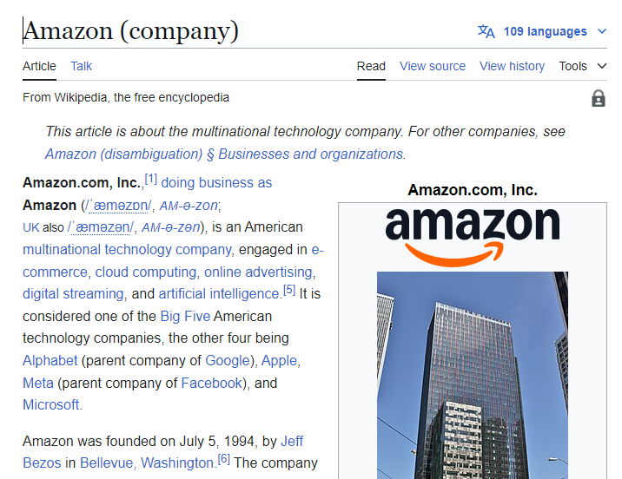
Back to the original question: How does Avery know that this request is coming from Amazon, Inc.?
How does Avery know that the party on the other end of the line is Amazon, Inc.?
A third-party (the "CA") can endorse that a public key is held by a certain real-world entity.
The third party issues a certificate containing the Amazon's public key, encrypted with its own private key.
Avery decrypts the certificate, using the CA's public key. Avery now has the public key of "Amazon Inc".
To acquire a certificate, Amazon.com will share their public key and some real-world proof that they are amazon.com to the CA.

Slide 43
How does Avery know that this request is coming from Amazon?
SSL is a protocol for encryption that uses asymmetric cryptography
Each party has a public key and a private key
Messages encrypted with a given public key can only be decrypted by matching private key
Messages signed with a given private key can be validated by anyone with the public key
A third-party can endorse that a public key is held by an entity and produce a certificate
amazon.com private key
amazon.com public key
amazon.com certificate
Notes:
Here's a summary of the story so far. To solve our original problem, we add one more idea: a certificate authority who can endorse that a certain public key is held by a certain real-world entity, in this case, the corporation Amazon, Incorporated.

Slide 44
Back to the original question: How does Avery know that this request is coming from Amazon, Inc.?
Avery can rely on a third party, called a "certificate authority" (CA).
The CA can endorse that a public key is held by a certain real-world entity.
The third party issues a certificate containing the Amazon's public key, encrypted with the CA's own private key.
When our browser visits amazon.com, amazon.com sends its certificate to our browser.
Avery decrypts the certificate, using the CA's public key. Avery now has the real public key of "Amazon Inc".
To acquire a certificate, Amazon, Inc. must have shared their public key and some real-world proof that they are amazon.com to the CA.

Slide 45
Certificate Authorities issue SSL Certificates
Amazon
Certificate Authority
CA private key
CA private key
amazon.com private key
amazon.com certificate
(AZ’s public key + CA’s sig)
CA public key
My Laptop
amazon.com public key
amazon.com public key
Some real-world proof that we are really amazon.com
CA public key
amazon.com certificate
(AZ’s public key + CA’s sig)
Notes:
Certificate authorities create SSL certificates using asymmetric (aka public/private key) cryptography.
Here is a a brief overview of the trust relationships when an SSL certificate is granted, and when it is checked by a browser.
The process starts out as follows:
Amazon.com has some public key and private key
Certificate authority has some public key and private key
Everyone who trusts the CA has the CA’s public key. This is distributed with OS’s. That is, we must trust the CA.
(build until proof of amazon.com appears on right) To acquire a certificate, Amazon.com will share their public key and some real-world proof that they are amazon.com to the CA
(build until certificate appears and moves back to left) the CA will use their private key to sign amazon’s public key, noting that they are endorsing this public key as being held by amazon.com
(build once) then, when we visit amazon.com, the server will present its certificate, which our browser can validate by checking that it is signed by the CA’s private key (which we do using the public key)

Slide 46
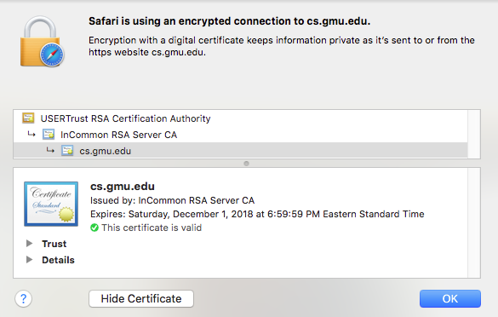
Why should we trust the CA?
For this to work, we had to already know the CA's public key
There are a small set of “root” CA’s (think: root DNS servers)
Every computer/browser is shipped with these root CA public keys
Notes:
(read slide)

Slide 47
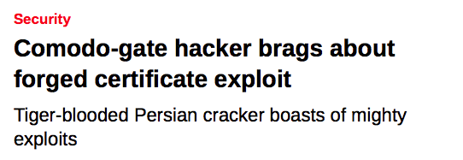
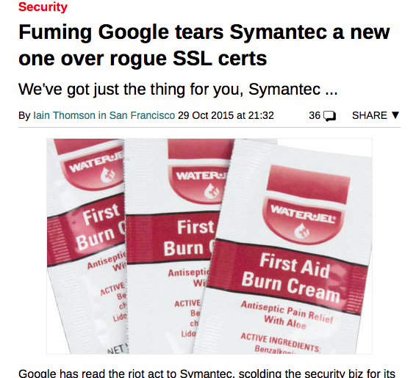
What happens if a CA is compromised, and issues invalid certificates?
Notes:
Oops…
As we saw, placing code in a trusted environment and using SSL to protect communication between trusted components is a great approach to mitigate threats to our execution environment (although it’s not perfect).

Slide 48
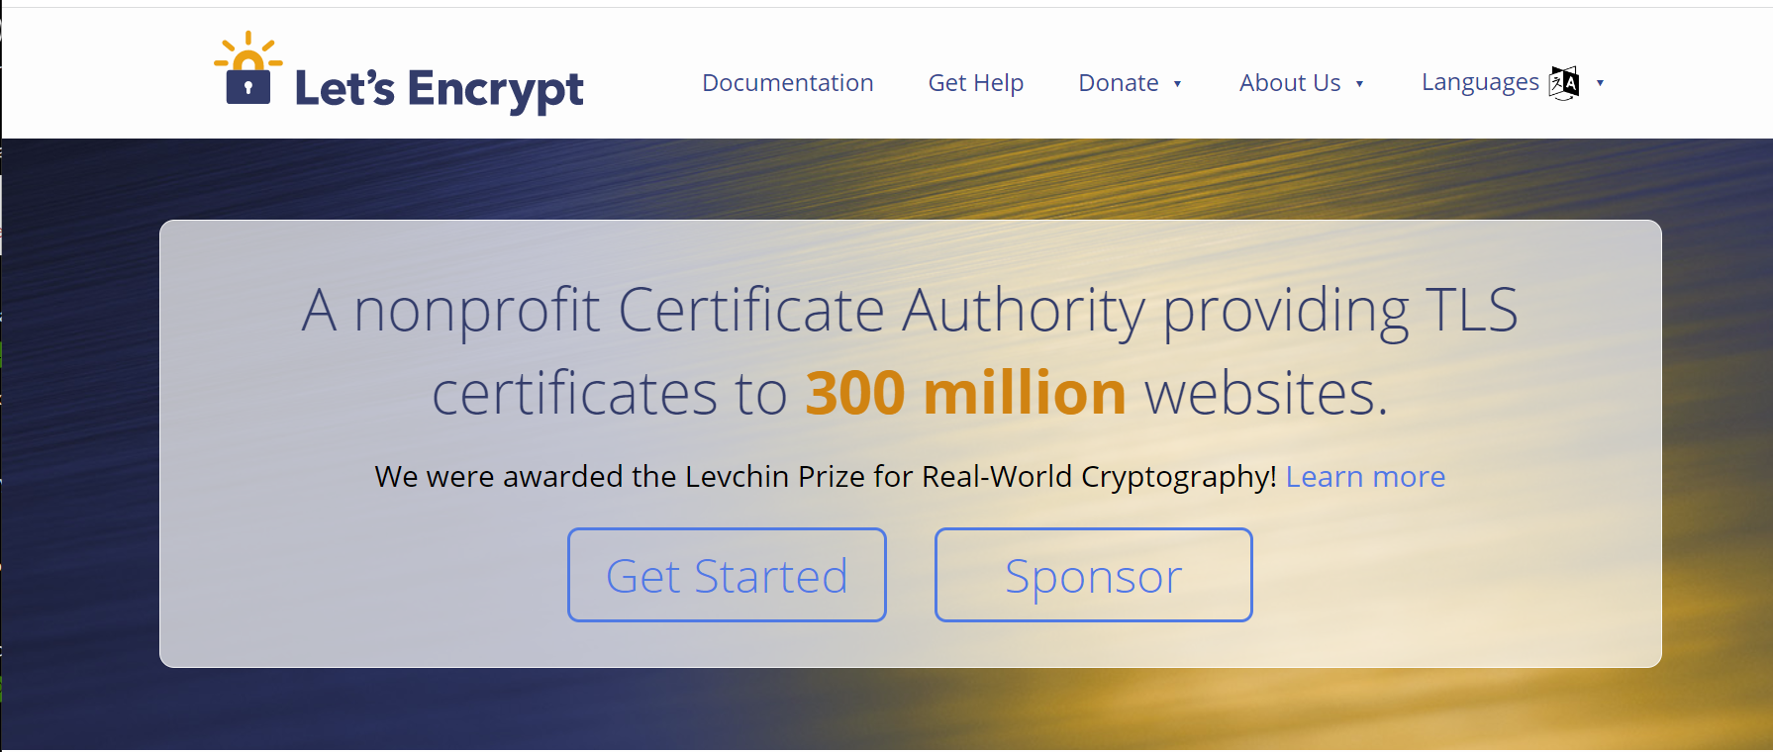
You can do this for your website for free
letsencrypt.com

Slide 49
Other mitigations for access-control threats
Implement multi-factor authentication
Make sure passwords are not weak, have not been compromised.
Apply per-record access control
Principle of least privilege
Harden pathways for account creation, password reset.
Use an expert vendor, like Auth0, to handle login
They might do it better than you can.
Notes:
Prof. Wand says: Password reset is particularly nasty. I had a friend (let’s call him Dave) whose ccs email password was hijacked by a bad guy. Since many, if not all, of Dave’s other accounts were linked to his ccs email, the bad guy could reset Dave’s passwords on all his other accounts. This happened on a weekend, and I had to telephone somebody in the Systems group to lock Dave’s email account *immediately* to minimize further damage.
The moral of the story is that your email password is particularly valuable, because a bad guy can use it to reset passwords on all your other accounts.

Slide 50
Vulnerability 4: Supply-Chain Attacks
Do we trust our own code?
Third-party code provides an attack vector
Notes:
Next, let’s consider so-called software supply chain threats.

Slide 51
The software supply chain has many points of weakness
External dependencies
Build process
Distribution process (including updates)
Operating environment
In-house code
Notes:
The “software supply chain” includes many potential points of weakness. We might need to consider threats at each phase of the software development and deployment process, including:
External dependencies: potential for malicious dependencies
In-house code: potential for insider attack (a developer who is either malicious, or whose laptop has been otherwise compromised through another vulnerability)
Build process: potential for build system to be compromised through another vulnerability or insider attack
Distribution process: potential for a malicious update to be pushed out to your customers
Operating environment: potential for other threats in the operating environment to result in a compromise of our software

Slide 52
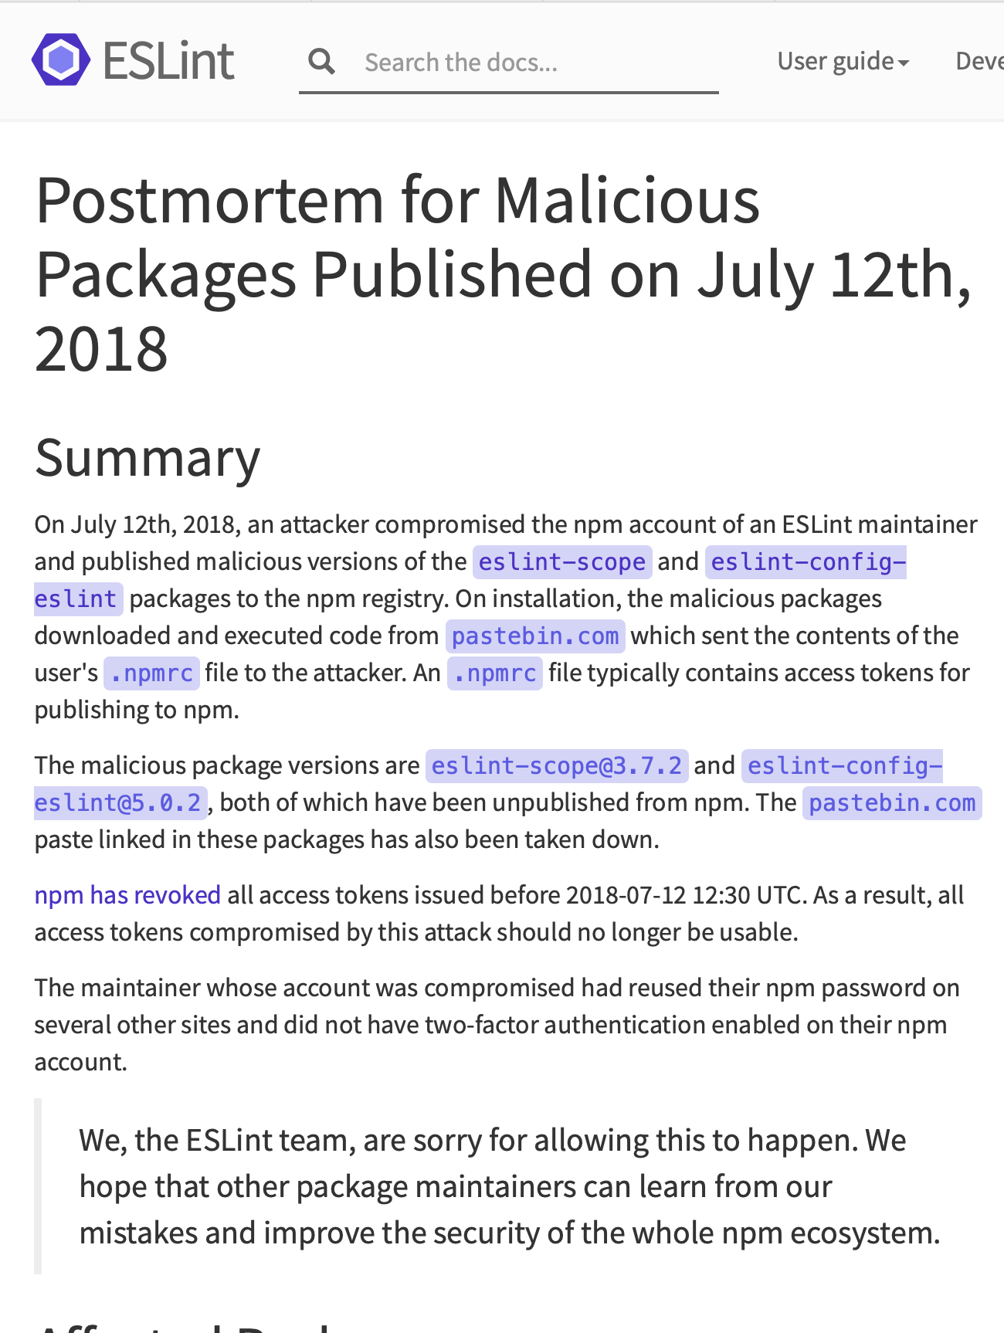
Example: the eslint-scope attack (2018)
On 7/12/2018, a malicious version of eslint-scope was published to npm.
eslint-scope is a core element of eslint, so many many users were affected.
Let’s analyze this…
https://eslint.org/blog/2018/07/postmortem-for-malicious-package-publishes/
Notes:
Let’s look at a couple of examples. In 2018, a malicious version of an eslint package called eslint-scope was published. This was a quite serious issue.
https://eslint.org/blog/2018/07/postmortem-for-malicious-package-publishes/

Slide 53
This incident leveraged several small security failures
An eslint-scope developer used their same password on another site.
The other site did not use 2FA
Password was leaked from the other site.
Attacker created malicious version of eslint-scope
Many users did not use package-lock.json, so their packages automatically installed the new (evil) version.
The malicious version sent copies of the user’s .npmrc to the attacker. This file typically contains user tokens.
Estimated 4500 tokens were leaked and needed to be revoked.
Notes:
Let’s look at the sequence of events, as explained in the post-mortem report on the preceding slide.
<Read Slide>
Discuss: how many violations of good security practices do you see here?
The developer used the same password on two different sites
The other site did not use 2FA
The other site did something else that allowed the password to leak.
Users did not protect their packages against silent version updates.

Slide 54
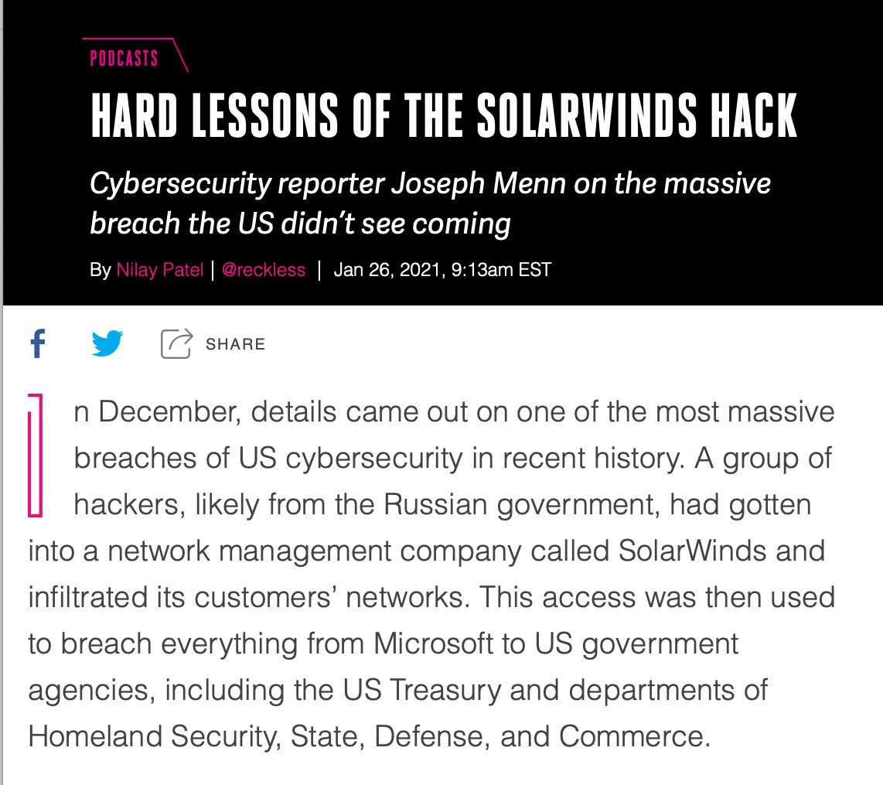
Example: the SolarWinds attack (2020)
Many networks compromised
Not discovered for months

Slide 55
This problem was recognized ages ago
Ken Thompson (the Unix guy) - 1984
Showed how to plant a bug in a compiler, so that any program compiled by that compiler would contain a backdoor.
The final step is represented in Figure 3.3. This simply adds a second Trojan horse to the one that already exists. The second pattern is aimed at the C compiler. The replacement code is a Stage I self-reproducing program that inserts both Trojan horses into the compiler. This requires a learning phase as in the Stage II example. First we compile the modified source with the normal C compiler to produce a bugged binary. We install this binary as the official C. We can now remove the bugs from the source of the compiler and the new binary will reinsert the bugs whenever it is compiled. Of course, the login command will remain bugged with no trace in source anywhere
Notes:
Ken Thompson, in his Turing lecture from 1984, wrote a 3-page paper showing how to plant a back door in the C compiler that would be undetectable by any inspection of the compiler's source code (!)

Slide 56
A 2021 NCSU/Microsoft found that many of the top 1% of npm packages had vulnerabilities
Package inactive or deprecated, yet still in use
No active maintainers
At least one maintainer with an inactive (purchasable) email domain
Too many maintainers or contributors to make effective maintenance or code control
Maintainers are maintaining too many packages
Many statistics/combinations: see the paper for details.
“What are Weak Links in the npm Supply Chain?” By: Nusrat Zahan, Thomas Zimmermann, Patrice Godefroid, Brendan Murphy, Chandra Maddila, Laurie Williams https://arxiv.org/abs/2112.10165
Notes:
Here is a list of significant vulnerabilities found in the most popular packages (“top 1%”).

Slide 57
Your suppliers' risks are your risks.
MOVEit is a file transfer program owned by Progress Software.
Over 2500 organizations used the program to move sensitive personal data.
They were attacked in May 2023.
Prof. Wand says: my bank didn't use MOVEit, but they used a supplier who did.
Now, they have to take expensive steps to offer me identity-protection services, etc.
Notes:
Prof. Wand says: I received two letters like this from two of my financial institutions within a week.

Slide 58
Threat Mitigation: Process-based problems need process-based solutions
External dependencies
Audit all dependencies and their updates before applying them
In-house code
Require developers to sign code before committing, require 2FA for signing keys, rotate signing keys regularly
Build process
Audit build software, use trusted compilers and build chains
Distribution process
Sign all packages, protect signing keys
Operating environment
Isolate applications in containers or VMs
Notes:
While we could easily solve problems in our own code by bolting on some useful additional components (like using SSL), it’s not so easy to solve threats to our software supply chain process – there need to be process-based solutions for these process-based problems.
These kinds of threats are currently some of the most-talked about (and most feared) because they are complex to defend against.
For example: how do we audit dependencies? Who does that, and when? What is “secure enough” for a dependency?
Who loves needing to do 2FA for every time you sign into canvas? How much worse is it if you had to do it for each git commit?
Signatures are useful only insofar as we trust the signer. If a developer’s computer is compromised (say, through a phishing attack), what good is that signature? Same for distribution.
Perhaps the best news-you-can-use here is to isolate each application in its own container or VM, reducing the scope of security breaches to be isolated within that environment and not directly impacting other applications.

Slide 59

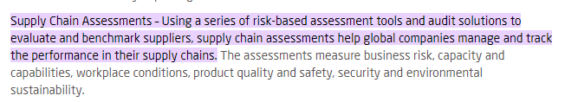
Supply-chain risks include more than just software.
Notes:
Of course, supply-chain security risks include more than just software. Your suppliers are subject to regulatory risks, transportation risks, etc, etc. Will your supplier in West Arstotzka (*) be taken over by the government, or overrun by mercenaries or rioters?
So of course there are consultants to help you manage all that. Here’s the web page of one such firm. (found after 30 seconds of googling)
[* Arstzoska is the name of a fictional country I found on Wikipedia]

Slide 60
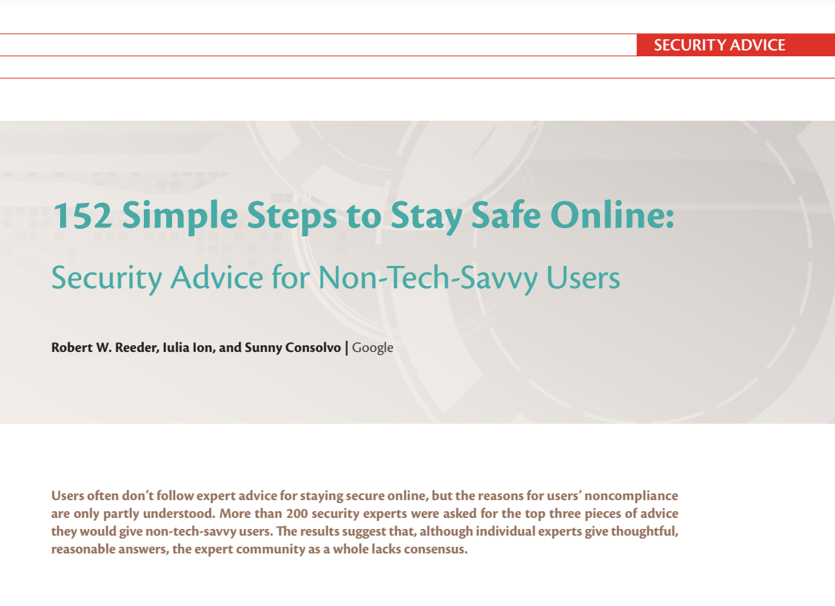
Vulnerability 5: Failure to Apply Security Policy
IEEE Security & Privacy 15:5 (2017)
Notes:
Here’s an article with a title that neatly summarizes the situation.

Slide 61
Outline of this lecture
Definition of key vocabulary
Some common vulnerabilities, and possible mitigations
Getting security right is about people as well as software.
Notes:
This brings us to the third item in our outline (from way back on slide 3)

Slide 62
Other mitigations for access-control threats
Implement multi-factor authentication
Make sure passwords are not weak, have not been compromised.
Apply per-record access control
Principle of least privilege
Harden account creation, password reset pathways
Use an expert vendor, like Auth0, to handle login
They can do it better than you can.
But how do you get your developers to do all this?
Notes:
That article described the situation faced by end users, but the situation for developers is even worse: developers have to keep their personal devices secure, but they also have to produce systems that defend against the attacks we’ve discussed.
<click>
But all the mitigations in the world won’t help you if you can’t get the people in your organization to use them.
Whatever the security policy is, you have to get your developers to apply it.

Slide 63

David Blank-Edelman (former head of Systems at Khoury)
“The solution is in front of the screen, not behind it”
Notes:
As David Blank-Edelman(*) used to say: “the solution is in front of the screen, not behind it.”
(*) former head of Systems at Khoury

Slide 64
A security architecture must include a security culture
Security architecture is a set of mechanisms and policies that we build into our system to mitigate risks from threats
Vulnerability: a characteristic or flaw in system design or implementation, or in the security procedures, that, if exploited, could result in a security compromise
Threat: potential event that could compromise a security requirement
Attack: realization of a threat
Notes:
It’s not just software, it’s not just company policy– we need to make sure our development teams have a culture that includes security.

Slide 65
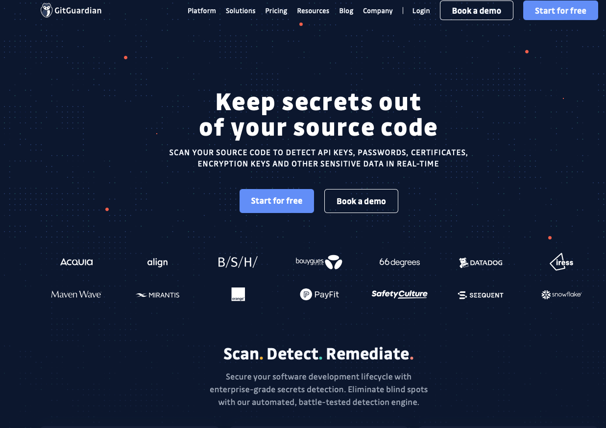
Example mechanism: secret detection
Recall: SSL only is effective if the private key… remains private
Applications may have many other secret values (e.g. access tokens for other services)
Tools like GitGuardian automatically detect secrets in repositories

Slide 66
Mechanisms aren’t enough: Do developers keep secret keys secret?
Industrial study of secret detection tool in a large software services company with over 1,000 developers, operating for over 10 years
What do developers do when they get warnings of secrets in repository?
49% remove the secrets; 51% bypass the warning
Why do developers bypass warnings?
44% report false positives, 6% are already exposed secrets, remaining are “development-related” reasons, e.g. “not a production credential” or “no significant security value”
Is it a management problem or a tool problem?
“Why secret detection tools are not enough: It’s not just about false positives - An industrial case study”
Md Rayhanur Rahman, Nasif Imtiaz, Margaret-Anne Storey & Laurie Williams https://link.springer.com/article/10.1007/s10664-021-10109-y
Notes:
Simply using a secret detection tool isn’t enough. This is an interesting study.
(Read slide for key findings)
Discussion:
Bypassing warnings for false positives (e.g. not an actual credential) are reasonable (although perhaps annoying); the remaining reasons that are “development related” such as: * It is not a production credential (for example, it is a credential for a non-shipping prototype)
The credential doesn’t protect any data, service, etc., with significant security value
Rely on judgement calls of the developer that do not reflect overall security model. Many successful attacks rely on chaining multiple vulnerabilities together, getting a foothold in one system to then be able to access another. These kinds of judgement calls should not be made at the level of individual developers who may not see the whole security landscape.
Other reasons why secrets not promptly removed:
* Removing the credential now would break services. etc., that belong to other teams
* We were not sure what secret management/other solution we can use to resolve the problem.
These are process-related issues, and require

Slide 67
Elements of a security culture
Make security a regular part of the process.
Include security tools as part of the build/release process
Tools may have false positives and false negatives
Educate developers about when how to recognize positives that look false, but aren’t
Include security review as regular part of code review
Notes:
<read slide>

Slide 68
Learning Objectives for this Module
You should now be able to:
Define key terms relating to software/system security
Describe some of the tradeoffs between security and other requirements in software engineering
Explain 5 common vulnerabilities in web applications and similar software systems, and describe some common mitigations for each of them.
Explain why software alone isn’t enough to assure security

